Slide 1
WEB AND INTERNET PROGRAMMING
CSE 4033
Course Group Address:
https://groups.yahoo.com/neo/groups/....
Text Book:
Marty Hall: Core Web Programming.
Deital and Deital: Internet and World Wide Web How to Program
Deital and Deital: Java How to Program

Slide 2
HTML
Creating a Basic Web Page

Slide 3
HTML Source Document
When you connect to a web page by entering its URL into the browser
  Browser instructs your computer to send a message out over the Internet to the computer specified by that URL requests that it sends back a certain document (HTML source doc)
  HTML source doc describes the content and layout of the web page
  After your computer receives the html, your browser interprets the html and displays the resulting web page (text/graphics/links etc)

Slide 4
HTML Source Document
HTML source document
  A text-only document
  Consists of (1) actual text, and (2) tags
A tag is an html code that is enclosed in angel brackets <>; used to layout the web page.
XHTML is a simple, more standardized version of HTML
XHTML/HTML can be created using a simple text editor like notepad
File extension must be .html or .htm

Slide 5
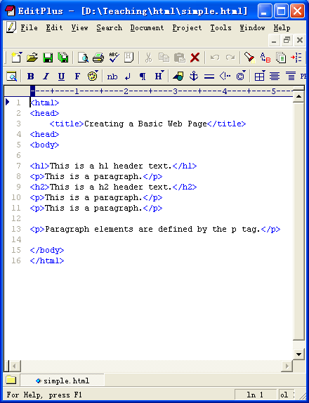
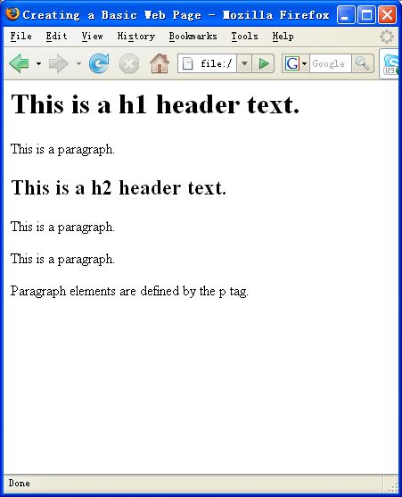
Sample HTML
HTML Source
Firefox display of the html source

Slide 6
HTML, XML, XHTML
XML (eXtensible Markup Language):
  is a set of rules that lets web designers classify their data in a way customized to their needs.
  Extendable by creating new types of tags.
XHTML (eXtensible HyperText Markup Language):
  A new version of HTML based on XML
  Inherits strict syntax rules of XML

Slide 7
HTML vs. XHTML
Some comparisons of HTML vs. XHTML
HTML | XHTML
Tags aren’t extensible | Tags are extensible
Tags are not case-sensitive | Only lowercase tags are allowed
Possible to leave off and ending tag like </body> | Tags should appear in pairs
Overlapping tags | No overlapping tags

Slide 8
Composition of a XHTML Document
An XHTML document consists of three main parts:
  the DOCTYPE
  the Head
  the Body

Slide 9
Composition of a XHTML Document
<!DOCTYPE html PUBLIC "-//W3C//DTD XHTML 1.0 Strict//EN" "http://www.w3.org/TR/xhtml1/DTD/xhtml1-strict.dtd">
<html xmlns="http://www.w3.org/1999/xhtml">
<head>
<meta http-equiv="content-type" content="text/html; charset=utf-8" />
...
<title>…</title>
</head>
<body>
…
</body>
</html>

Slide 10
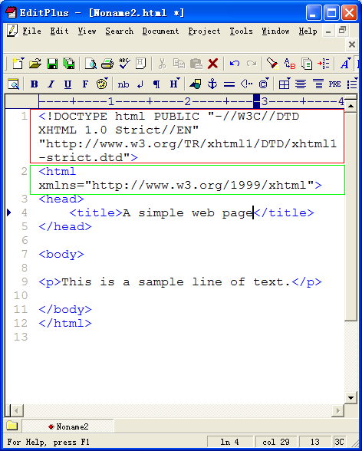
Creating XHTML
The code inside red rectangle (<!DOCTYPE … dtd”>) is a Document Type Definition (DTD), it specifies what type of document this is – in this case an XHTML document.
The code inside green rectangle, xmlns specifies the namespace, it tells the browser that all tags contained within the <html> tag belong to the XHTML namespace as defined by the W3C and located at the given URL.

Slide 11
XHTML Tags/Elements
Tags are also called elements
An attribute is a special code that can enhance or modify a tag. They are generally located in the starting tag after the tag name.
Basic syntax for xhtml tags and attributes
  <tag attribute="value"> </tag>
  All tags must be lower case
  all values of attributes need to surrounded by quotes

Slide 12
XHTML Tags/Elements
Example
  <strong>This is bold text…</strong>
  <p style =“text-align:center">This text will appear aligned to the center…</p>

Slide 13
<meta> tag
<meta> tag
  is used to specify keywords that describe a document’s contents as well as a short description.
Two necessary attributes – "name" & "content"
  <meta name="keywords" content="baseball, soccer, tennis"/>
  <meta name="description" content="Sports information page"/>

Slide 14
<p> paragraph tag
<p> tag
  The paragraph tag. Used so separate text within a web page.
  Container type
  Will provide line breaks
Optional attribute : align (not allowed in XHTML 1.0 Strict though)
  <p align="center">

Slide 15
<br/> tag
<br/> tag
  Is used for line break
Example
<p>
Contact<br />
602 New Building<br />
Jagannath University<br />
Dhaka-1100
</p>

Slide 16
Headings
<h1> to <h6>
  Define headers. <h1> defines the largest header. <h6> defines the smallest header.
Example
<h1>This is header 1</h1>
<h2>This is header 2</h2>
<h3>This is header 3</h3>
<h4>This is header 4</h4>
<h5>This is header 5</h5>
<h6>This is header 6</h6>

Slide 17
<em> & <strong> tags
<em> tag
  Renders text as emphasized text
<strong> tag
  Renders text as strong emphasized text
Example
<em>Emphasized text</em><br />
<strong>Strong text</strong><br />

Slide 18
Commenting Source Code
Comments are inclosed in <!-- and -->
Example
<!--This comment will not be displayed-->
<p>This is a regular paragraph</p>

Slide 19
<blockquote> tag
<blockquote> tag
  tag defines the start of a long quotation.
To validate the page as strict XHTML, you must add a block-level element around the text within the <blockquote> tag, like this:
<blockquote>
<p>here is a long quotation here is a long quotation</p>
</blockquote>

Slide 20
Block-Level vs. Inline Elements
This works
  <h2><em>Bold and italic</em></h2>
How about this
  <em><h2>Bold and italic</h2></em>
Block-level element/tag
  define a complete section or block of text
  Can contain inline element and block-level element
Inline elements
  Define the structure of a sequence of characters within a line
  may not contain a block-level element
  may be used within a block

Slide 21
Block-Level vs. Inline Elements
Partial list of block-level tags
  p, blockquote, h1 … h6, div, ul, ol, li, table, tr, td, th
Partial list of inline tags
  a (anchor tag), em, strong, img, q (short quotation)
Element Hierarchy
http://www.ahuka.com/?page_id=119

Slide 22
Attribute
An attribute is a special code that can enhance or modify a tag. They are generally located in the starting tag after the tag name.
Basic syntax for xhtml tags and attributes
  <tag attribute="value"> </tag>
  All tags must be lower case
  all values of attributes need to be surrounded by quotes
Notes:
block-level elements generally start in a new line; something that doesn't apply to inline-level elements.

Slide 23
Common Attributes
id
  unique identifier for elements
class
  the class of the element, used to specify similar attributes for dissimilar elements by putting them in the same class
style
  an inline style definition
title
  a text to display in a tool tip
Notes:
block-level elements generally start in a new line; something that doesn't apply to inline-level elements.

Slide 24
Common Attributes
Examples 1
  <p id=“firstParag” class=“indent” title=“This paragraph introduces html attributes”>
  Assuming style sheet contains
  .indent { margin-right: 5%; margin-left: 5%;}
Example 2
  <p id=“firstParag” style=“margin-right: 5%; margin-left: 5%;” title=“This paragraph introduces html attributes”>
Notes:
block-level elements generally start in a new line; something that doesn't apply to inline-level elements.

Slide 25
Common Attributes
lang
  sets the language code; “en”: English, “fr”: French, “es”: Spanish, “de”: German etc.
dir
  sets the text direction, left to right or right to left
<p lang=“fr” dir=“ltr”>bonjour!</p>
accesskey
  assigns an access key to an element. An access key is a single character from the document character set.
tabindex
  Sets the tab order of an element
Notes:
block-level elements generally start in a new line; something that doesn't apply to inline-level elements.

Slide 26
Deprecated Attributes
In order to separate structure from presentation
  many HTML attributes/tags used for presentation were deprecated, starting from HTML version 4
Some deprecated attributes
  font, <font size=“5” color=“red”>Text</font>
  align, <p align=“center”>Centered text</p>
  bgcolor, width, height, etc.

Slide 27
Lists
Ordered lists & Unordered lists
  <ol> for ordered
  <ul> for unordered
  <li> for each item inside the list
Browser inserts a blank line before & after the list (block-level element)
Example
  <ol> <li>Item 1</li> <li>Item 2</li> <li>Item3</li> </ol>

Slide 28
Lists
Nested lists
  <ul>
  <li>Top Level, Item 1</li>
  <li>Top Level, Item 2
  <ul>
  <li>Sublevel 1, Item 1
  <ul>
  <li>Sublevel 2, Item 1</li>
  <li>Sublevel 2, Item 2</li>
  </ul>
  </li>
  <li>Sublevel 1, Item 2</li>
  </ul>
  </li>
  <li>Top Level, Item 3</li>
  </ul>

Slide 29
Customizing List Display
List numbers or marks can be customized
“type” attribute
Example
  <ul type=“square”>
  <ol type=“A”>
  <ol type=“a”>
  <ol type=“I”>
  <ol type=“i”>
“type” attribute is not allowed in XHTML 1.0 Strict, so use style sheets instead

Slide 30
Definition Lists
<dl> for list element; <dt> for “definition terms”; <dd> for “definition data”
Example
  <dl>
  <dt><strong>CPU</strong></dt>
  <dd>Central Processing Unit</dd>
  <dt><strong>ALU</strong></dt>
  <dd>Arithmetic Logic Unit</dd>
  <dt><strong>GHz</strong></dt>
  <dd>Gigahertz</dd>
  </dl>

Slide 31
Special Characters & Symbols
Special Character | Entity Name | Special Character | Entity Name
Ampersand | &amp; & | Greater-than sign | &gt; >
Asterisk | &lowast; ∗∗ | Less-than sign | &lt; <
Cent sign | &cent; ¢ | Non-breaking space | &nbsp;
Copyright | &copy; © | Quotation mark | &quot; "
Fraction one qtr | &frac14; ¼ | Registration mark | &reg; ®
Fraction one half | &frac12; ½ | Trademark sign | &trade; ™

Slide 32
Tables <table>
Tables used not only for displaying data in tabular format
A table (<table>) in HTML
  Consists of rows (<tr>)
  Each row consists of rectangular boxes called cells (<td>)
  <table>
  <tr><td>R1,Cell1</td><td>R1,Cell2</td></tr>
  <tr><td>R2,Cell1</td><td>R2,Cell2</td></tr>
  </table>

Slide 33
Tables
By default
  Text in each cell is automatically aligned to the left
  All the cells in a column have the same width
  Width of the column is determined by the cell with the most text in it
<th> for “table header”
<tr>
<th>Header1</th>
<th>Header2</th>
</tr>

Slide 34
Tables
Other attributes of <table>
  align, cellpadding, cellspacing, colspan
  Yet XHTML 1.0 Strict don’t allow this attributes, so use stylesheet instead
Other tags
  <caption>
  <colgroup>
  <thead>, <tfoot>, <tbody>

Slide 35
Table Data and Table Header Attributes
Colspan: Specifies how many cell columns of the table this cell should span.
Rowspan: Specifies how many cell rows of the table this cell should span.
Align: cell data can have left, right, or center alignment.
Valign: cell data can have top, middle, or bottom alignment.
Width: you can specify the width as an absolute number of pixels or a percentage of the document width.
Height: You can specify the height as an absolute number of pixels or a percentage of the document height.

Slide 36
Links
The true power of WWW comes with hyperlinks
Surfer click on a specially marked word or image on a web page and automatically be jumped to another web page or another place in the same web page.
  Another web page – External link
  Another place – Internal link
Use <a> (anchor) tag to create a link

Slide 37
Links
External Links
  <a href=“SomeURL”>Text/image</a>
Create a link to CS web page
  <a href=“http://www.cse.jnu.ac.bd/”>CSE Department at Jagannath University</a>
  Be careful about the quotation mark
Internal Links
Create a place/anchor
  <a id=“SomeLabel”></a> or
  <a id=“SomeLabel” name=“SomeLabel”/></a>
  Link to the anchor
    <a href=“#SomeLabel”>Go to some place</a>

Slide 38
Links
Combining External and Internal Links
  <a href=“SomeURL#SomeLabel>Link Text</a>

Slide 39
Images <img>
Insert an image using <img> tag
  <img src=“URL of the image file” />
Image can an image on a remote machine on the Internet, or an image in your local machine.
Examples,
  <img src="http://www.cse.jnu.ac.bd/images/gallery/festival.jpg"/>
  <img src="../images/orientation.jpg" />

Slide 40
Images
Alternative Text for images
  <img src=“Image URL” alt=“Alternative Text” />
Example
  <img src="../images/orientation.jpg" alt=“Orientation 1st Batch"/>
width & height attributes
  <img src="../images/orientation.jpg" alt=" Orientation 1st Batch " width="257" height="161" />
Use style sheet instead of attributes, even though XHTML 1.0 Strict supports these two attributes

Slide 41
Image Maps
Image maps are images, usually in gif format that have been divided into regions; clicking in a region of the image cause the web surfer to be connected to a new URL.
Image maps are graphical form of creating links between pages.
There are two type of image maps:
    Client side and server side
Both types of image maps involve a listing of co-ordinates that define the mapping regions and which URLs those coordinates are associated with. This is known as the map file.

Slide 42
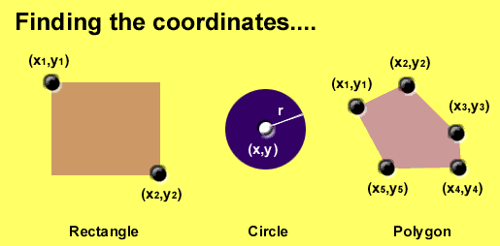
Area Shapes Used

Slide 43
Client-Side Image Maps
Client-side image maps (USEMAP) use a map file that is part of the HTML document (in an element called MAP), and is linked to the image by the Web browser.
<IMG SRC="note.GIF" Width=200 Height=200
border="5" USEMAP="#map1">
<MAP NAME="map1">
<AREA SHAPE="RECT" COORDS="0,0,90,90"
HREF="hi.html" ALT="see me…">
<AREA SHAPE="RECT" COORDS="100,100,160,160"
HREF="divPara.html" ALT="see him…" >
<AREA SHAPE="CIRCLE" COORDS="150,50,20"
HREF="house.html" ALT="see it…" >
</MAP>
We can use Poly as well as Rect……

Slide 44
Interactive Forms
Without forms, a Web site is “read-only” – it just provides information to the user
Forms enable the user to provide information to the Web site. For example, the user can:
  Perform searches on Web site
  Give comments
  Ask for info that is not available on the Website
  Place order for goods and services

Slide 45
Interactive Forms
Are GUI-based
Can contain a single element or many
Are always placed between the <BODY> and </BODY> tags of a Web page
May contain:
  Text fields
  Check boxes
  Buttons
  Scrollable lists

Slide 46
Interactive Forms
<form name=“form_name" method="post" action=“formURL">
Elements of the form
</form>
name: Name given to the form
method: Forms can be submitted through two alternate methods – GET & POST
action: Specifies the URL that is accessed when the form is being submitted

Slide 47
GET and POST Method
GET requests can be cached | POST requests are never cached
GET requests remain in the browser history | POST requests do not remain in the browser history
GET requests can be bookmarked | POST requests cannot be bookmarked
GET requests should never be used when dealing with sensitive data
GET requests have length restrictions | POST requests have no restrictions on data length
GET requests should be used only to retrieve data

Slide 48
Server-Side Scripts
Are programs that reside on Web servers
Receive info that a user enters in a form
Process that info and take appropriate action
Examples:
  CGI scripts on Unix servers
  ASP scripts on Windows servers

Slide 49
Form Elements
Text boxes, Password boxes, Checkboxes, Option(Radio) buttons, Submit, Reset, File, Hidden and Image.
Form elements have properties:
The properties are specified in the TYPE Attribute of the HTML element <INPUT></INPUT>.

Slide 50
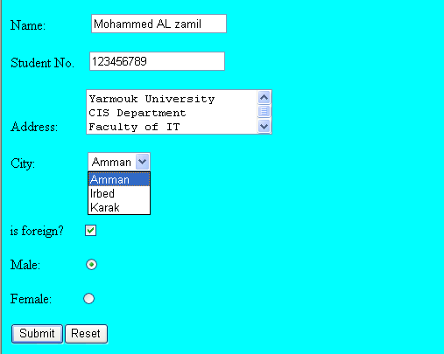
Kuddus Mia

Slide 51
Form Elements
<INPUT> Element’s Properties
TYPE= Type of INPUT entry field.
NAME = Variable name passed to CGI application
VALUE= The data associated with the variable name to be passed to the CGI application
CHECKED= Button/box checked
SIZE= Number of visible characters in text field
MAXLENGHT= Maximum number of characters accepted.

Slide 52

Text Box
Text boxes: Used to provide input fields for text, phone numbers, dates, etc.
<INPUT TYPE= " TEXT " >
Browser will display
Textboxes use the following attributes:
TYPE: text.
SIZE: determines the size of the textbox in characters. Default=20 characters.
MAXLENGHT : determines the maximum number of characters that the field will accept.
NAME: is the name of the variable to be sent to the CGI application.
VALUE: will display its contents as the default value.

Slide 53
Example on Text Box
<TITLE>Form_Text_Type</TITLE>
</HEAD> <BODY>
<h1> <font color=blue>Please enter the following bioData</font></h1>
<FORM name="fome1" Method= " get " Action= " URL " >
First Name: <INPUT TYPE="TEXT" NAME="FName"
SIZE="15" MAXLENGTH="25"><BR>
Last Name: <INPUT TYPE="TEXT" NAME="LName"
SIZE="15" MAXLENGTH="25"><BR>
Nationality: <INPUT TYPE="TEXT" NAME="Country"
SIZE="25" MAXLENGTH="25"><BR>
The Phone Number: <INPUT TYPE="TEXT" NAME="Phone"
SIZE="15" MAXLENGTH="12"><BR>
</FORM> </BODY> </HTML>

Slide 54
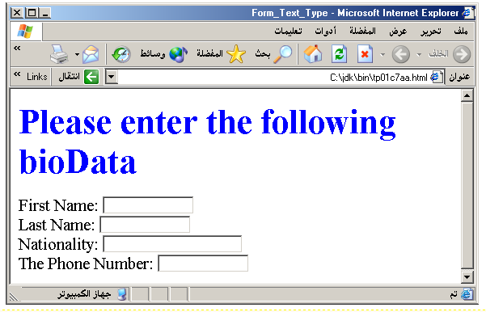
Output

Slide 55
Password
Password: Used to allow entry of passwords.
<INPUT TYPE= " PASSWORD " >
Browser will display
Text typed in a password box is starred out in the browser
display.
Password boxes use the following attributes:
TYPE: password.
SIZE: determines the size of the textbox in characters.
MAXLENGHT: determines the maximum size of the password in characters.
NAME: is the name of the variable to be sent to the CGI application.
VALUE: is usually blank.

Slide 56
Example on Password Box
<HTML><HEAD>
<TITLE>Form_Password_Type</TITLE></HEAD>
<BODY>
<h1> <font color=red>To Access, Please
enter:</font></h1>
<FORM name="fome2" Action="url" method="get">
User Name: <INPUT TYPE="TEXT" Name="FName"
SIZE="15" MAXLENGTH="25"><BR>
Password: <INPUT TYPE="PASSWORD"
NAME="PWord" value="" SIZE="15”
MAXLENGTH="25"><BR>
</FORM></BODY> </HTML>

Slide 57
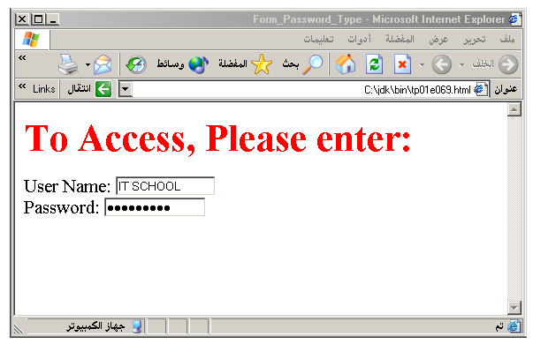
Output

Slide 58
Hidden
Hidden: Used to send data to the CGI application that you don’t want the web surfer to see, change or have to enter but is necessary for the application to process the form correctly.
<INPUT TYPE=“HIDDEN”>
Nothing is displayed in the browser.
Hidden inputs have the following attributes:
TYPE: hidden.
NAME: is the name of the variable to be sent to the CGI application.
VALUE: is usually set a value expected by the CGI application.

Slide 59
Check Box
Check Box: Check boxes allow the users to select more than one option.
<INPUT TYPE=“CHECKBOX”>
Browser will display
Checkboxes have the following attributes:
TYPE: checkbox.
CHECKED: is blank or CHECKED as the initial
status.
NAME: is the name of the variable to be sent to the
CGI application.
VALUE: is usually set to a value.

Slide 60
Example on Checked Box
<HTML> <HEAD><TITLE>CheckBoxType</TITLE> </HEAD>
<BODY>
<h1> <font color=green>Please check one of the following</font></h1>
<FORM name="fome3" Action="url" method="get">
<font color=red> Select Country: </font><BR>
jordan:<INPUT TYPE="CheckBox" Name="country" CHECKED><BR>
Yemen<INPUT TYPE="CheckBox" Name="country"><BR>
Qatar:<INPUT TYPE="CheckBox" Name="country"><BR> <BR>
<font color=blue>Select Language:</font><BR>
Arabic:<INPUT TYPE="CheckBox" Name="language" CHECKED><BR> English:<INPUT TYPE="CheckBox" Name="language"><BR>
French:<INPUT TYPE="CheckBox" Name="language"> <BR></FORM> </BODY></HTML>

Slide 61
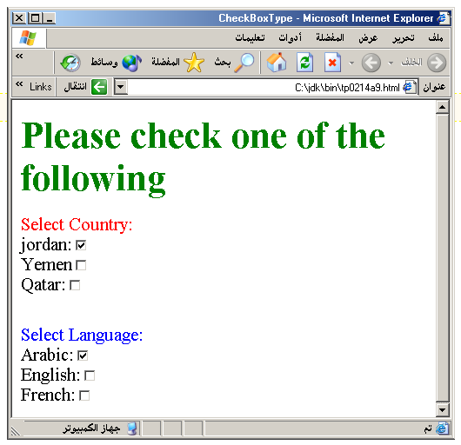
Output

Slide 62
Radio Button
Radio Button: Radio buttons allow the users to select only one option.
<INPUT TYPE=“RADIO”>
Browser will display Radio buttons have the following attributes:
TYPE: radio.
CHECKED: is blank or CHECKED as the initial
status. Only one radio button can be
checked
NAME: is the name of the variable to be sent to the
CGI application.
VALUE: usually has a set value.

Slide 63
Example on Radio Button
<HTML> <HEAD><TITLE>CheckBoxType</TITLE> </HEAD>
<BODY>
<h1> <font color=green>Please check one of the following</font></h1>
<FORM name="fome3" Action="url" method="get">
<font color=red> Select Country: </font><BR>
jordan:<INPUT TYPE= "RADIO" Name="country" CHECKED><BR>
Yemen<INPUT TYPE="RADIO " Name="country"><BR>
Qatar:<INPUT TYPE="RADIO" Name="country"><BR> <BR>
<font color=blue>Select Language:</font><BR>
Arabic:<INPUT TYPE="RADIO" Name="language" CHECKED><BR> English:<INPUT TYPE=" RADIO " Name="language"><BR>
French:<INPUT TYPE=" RADIO " Name="language"> <BR></FORM> </BODY></HTML>

Slide 64
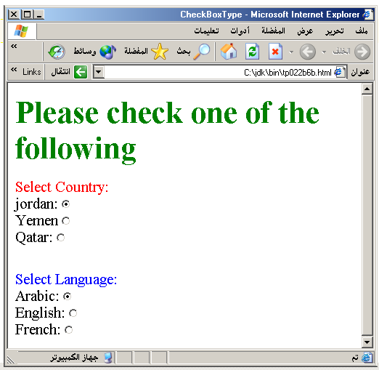

Slide 65
Push Button
Push Button: This element would be used with
JavaScript to cause an action to take place.
<INPUT TYPE=“BUTTON”>
Browser will display
Push Button has the following attributes:
TYPE: button.
NAME: is the name of the button to be used
in scripting.
VALUE: determines the text label on the button.

Slide 66
Submit Button
Submit: Every set of Form tags requires a Submit button. This is the element causes the browser to send the names and values of the other elements to the CGI Application specified by the ACTION attribute of the FORM element.
<INPUT TYPE=“SUBMIT”>
The browser will display
Submit has the following attributes:
TYPE: submit.
NAME: value used by the CGI script for processing.
VALUE: determines the text label on the button, usually Submit Query.

Slide 67
Example on Submit Button
<FORM Action="URL" method="get">
First Name: <INPUT TYPE="TEXT" Size=25 name="firstName"><BR>
Family Name: <INPUT TYPE="TEXT" Size=25 name="LastName"><BR>
<BR>
<FONT Color=red>
Press Here to submit the data:<BR>
<INPUT TYPE="submit" VALUE="SubmitData " >
</FORM>

Slide 68
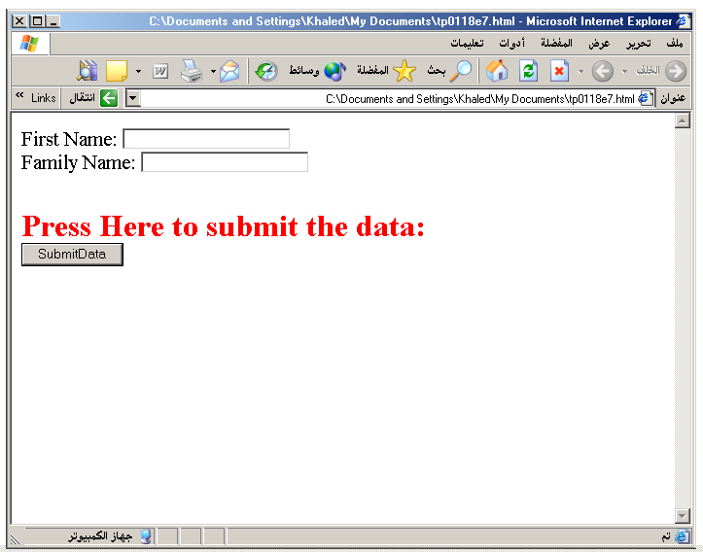

Slide 69
Reset Button
Reset: It is a good idea to include one of these for each form where users are entering data. It allows the surfer to clear all the input in the form.
<INPUT TYPE=“RESET”>
Browser will display
Reset buttons have the following attributes:
TYPE: reset.
VALUE: determines the text label on the button, usually Reset.

Slide 70
Example on Reset Button
<FORM Action="URL" method="get">
First Name: <INPUT TYPE="TEXT" Size=25 name="firstName"> <BR>
Family Name: <INPUT TYPE="TEXT" Size=25 name="LastName"><BR>
<BR>
<FONT Color = red>
<STRONG><font size=5>Press Here to submit the data:</font></STRONG><BR>
<INPUT TYPE="submit" VALUE="SubmitData">
<INPUT TYPE="RESET" VALUE="Reset">
</FORM>

Slide 71
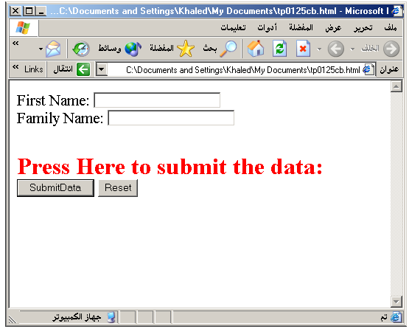

Slide 72
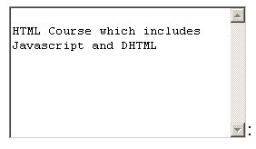
TextArea
<TEXTAREA></TEXTAREA>: is an element that allows for free form text entry.
Textarea has the following attributes:
NAME: is the name of the variable to be sent to the CGI application.
ROWS: the number of rows to the textbox.
COLS: the number of columns to the textbox.

Slide 73
Example on TextArea
<BODY bgcolor=lightblue>
<form>
<TEXTAREA COLS=40 ROWS=20 Name="comments" >
From observing the apathy of those
about me during flag raising I
concluded that patriotism if not
actually on the decline is at least
in a state of dormancy.
Written by Khaled Al-Fagih
</TEXTAREA>:
</form>
</BODY>

Slide 74
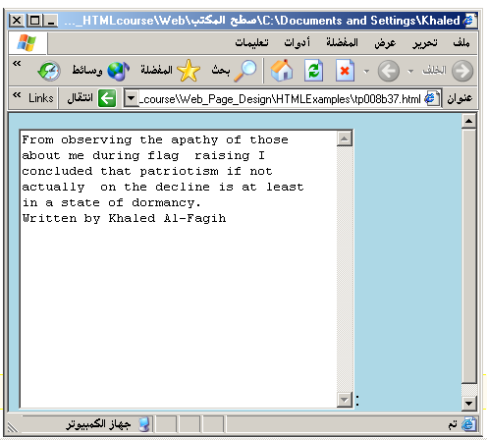

Slide 75
Wrap Attribute
WRAP describes how the text in the text area should wrap at the end of lines.
Until this attribute came along, browsers generally did not do word wrapping.
If you typed a line that was longer than the display area, the line just kept going, hopefully with the display area scrolling along.

Slide 76
Wrap Attribute
Value | Description
soft | The text in the textarea is not wrapped when submitted in a form. This is default
hard | The text in the textarea is wrapped (contains newlines) when submitted in a form. When "hard" is used, the cols attribute must be specified

Slide 77
Other Elements used in Forms
The two following examples are <SELECT></SELECT> elements, where the attributes are set differently.
The Select elements attributes are:
NAME: is the name of the variable to be sent to the CGI application.
SIZE: this sets the number of visible choices.
MULTIPLE: the presence of this attribute signifies that the user can make multiple selections. By default only one selection is allowed.

Slide 78
<BODY bgcolor=lightblue>
<form>
Select the cities you have visited:
<SELECT name=“list” size=5>
<option> London</option>
<option> Tokyo</option>
<option> Paris</option>
<option> New York</option>
<option> LA</option>
<option> KL</option>
</SELECT>
</form>
</BODY>

Slide 79
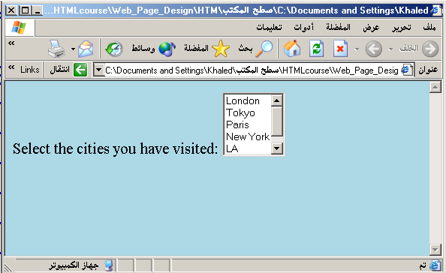

Slide 80
Other Elements used in Forms
Drop Down List:
Name: is the name of the variable to be sent to the CGI application.
Size: 1.

Slide 81

Other Elements used in Forms
List Box:
Name: is the name of the variable to be sent to the CGI application.
SIZE: is greater than one.

Slide 82
Other Elements used in Forms
Option
The list items are added to the <SELECT> element by inserting <OPTION></OPTION> elements.
The Option Element’s attributes are:
SELECTED: When this attribute is present, the option is selected when the document is initially loaded. It is an error for more than one option to be selected.
VALUE: Specifies the value the variable named in the select element.

Slide 83
</HEAD>
<BODY>
<h2><font color=blue>What type of Computer do you have?</font><h2>
<FORM>
<SELECT NAME="ComputerType" size=4>
<OPTION value="IBM" SELECTED> IBM</OPTION>
<OPTION value="INTEL"> INTEL</OPTION>
<OPTION value=" Apple"> Apple</OPTION>
<OPTION value="Compaq"> Compaq</OPTION>
</SELECT>
</FORM></BODY></HTML>

Slide 84
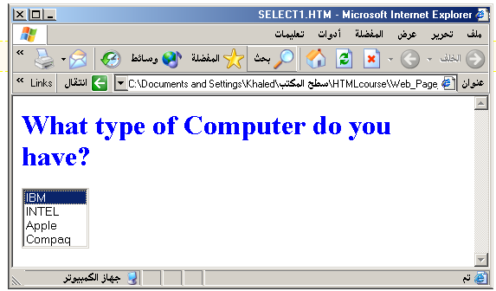

Slide 85
<HEAD> <TITLE>SELECT with Mutiple </TITLE> </HEAD>
<BODY>
<h2><font color=blue>What type of Computer do you have?</font><h2>
<FORM>
<SELECT NAME="ComputerType" size=5 multiple>
<OPTION value="IBM" > IBM</OPTION>
<OPTION value="INTEL"> INTEL</OPTION>
<OPTION value=" Apple"> Apple</OPTION>
<OPTION value="Compaq" SELECTED> Compaq</OPTION>
<OPTION value=" other"> Other</OPTION>
</SELECT>
</FORM></BODY></HTML>

Slide 86
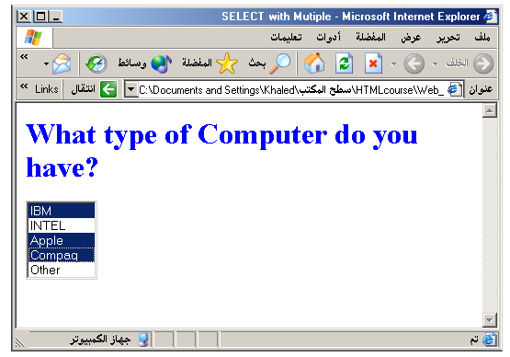

Slide 87
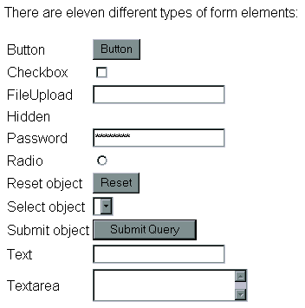

Slide 88
Suggested Reading
HTML Tutorials on
www.w3schools.com

